Slide 1
Cloud Computing
AWS(AMAZON WEB SERVICE)
Requirements:AWS FREE TIER ACCOUNT
For creating AWS account debit or credit card is needed which can be used for international transaction.(VISA,MASTERCARD,RUPAY)
SOFTWARE NEEDED:PUTTY

Slide 2
Cloud front
Amazon CloudFront is a web service that speeds up distribution of your static and dynamic web content, such as .html, .css, .js, and image files, to your users. CloudFront delivers your content through a worldwide network of data centers called edge locations. When a user requests content that you're serving with CloudFront, the request is routed to the edge location that provides the lowest latency (time delay), so that content is delivered with the best possible performance.

Slide 3
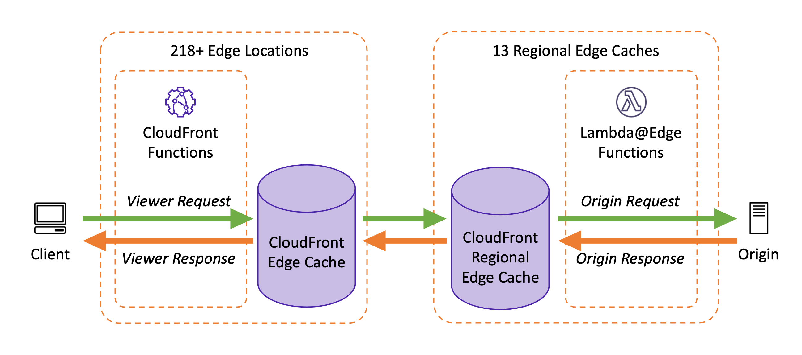

Slide 4
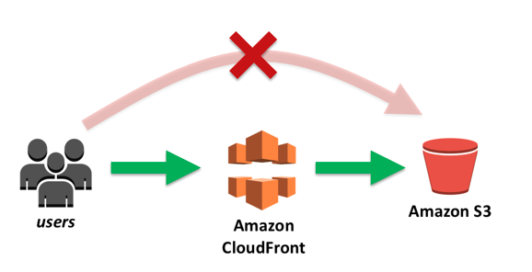

Slide 6
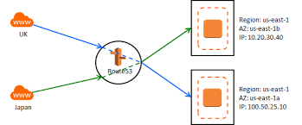
Amazon Route 53 is a highly available and scalable Domain Name System (DNS) web service. Route 53 connects user requests to internet applications running on AWS or on-premises.

Slide 7
What is Lambda used for in AWS?
AWS Lambda is a serverless compute service that runs your code in response to events and automatically manages the underlying compute resources for you. These events may include changes in state or an update, such as a user placing an item in a shopping cart on an ecommerce website

Slide 8
Cloud Front
f the content is already in the edge location with the lowest latency, CloudFront delivers it immediately.
If the content is not in that edge location, CloudFront retrieves it from an origin that you've defined—such as an Amazon S3 bucket, a MediaPackage channel, or an HTTP server (for example, a web server) that you have identified as the source for the definitive version of your content.

Slide 9
How to build network in cloud.
VPC--virtual private cloud

Slide 10
Load Balancer
A load balancer is a device that acts as a reverse proxy and distributes network or application traffic across a number of servers.
Load balancer types:
Application Load Balancer.
Network Load Balancer.
Application Load Balancer and Network Load Balancer considerations.
Classic Load Balancer

Slide 11
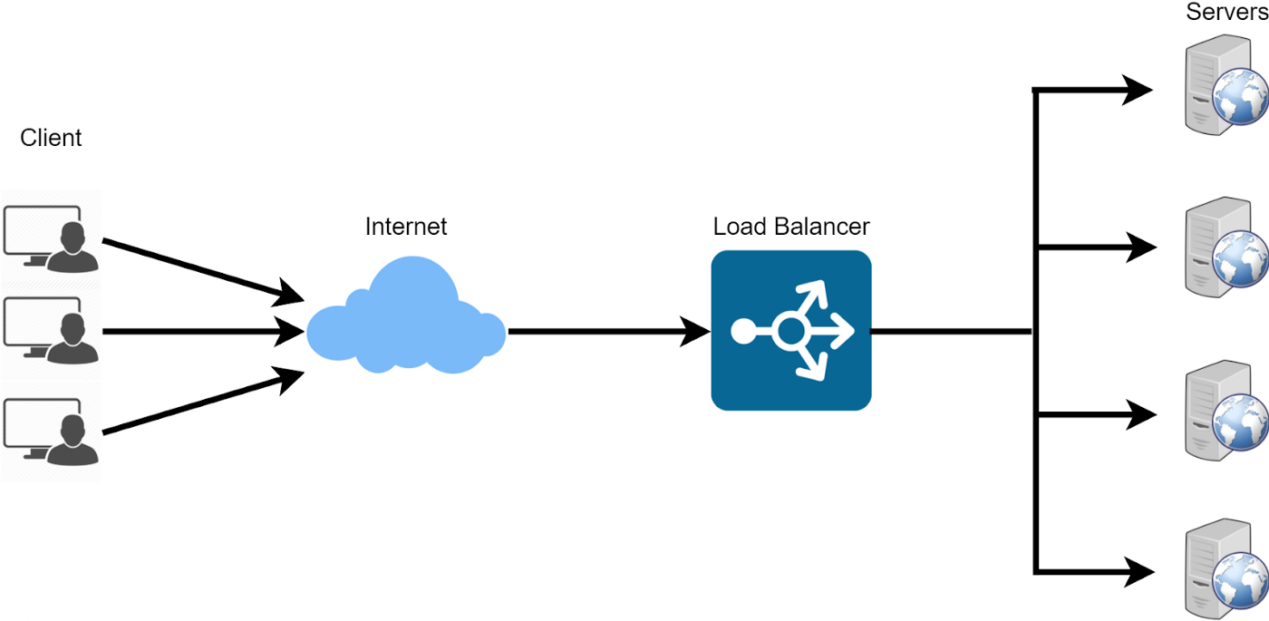
Load Balancer

Slide 13
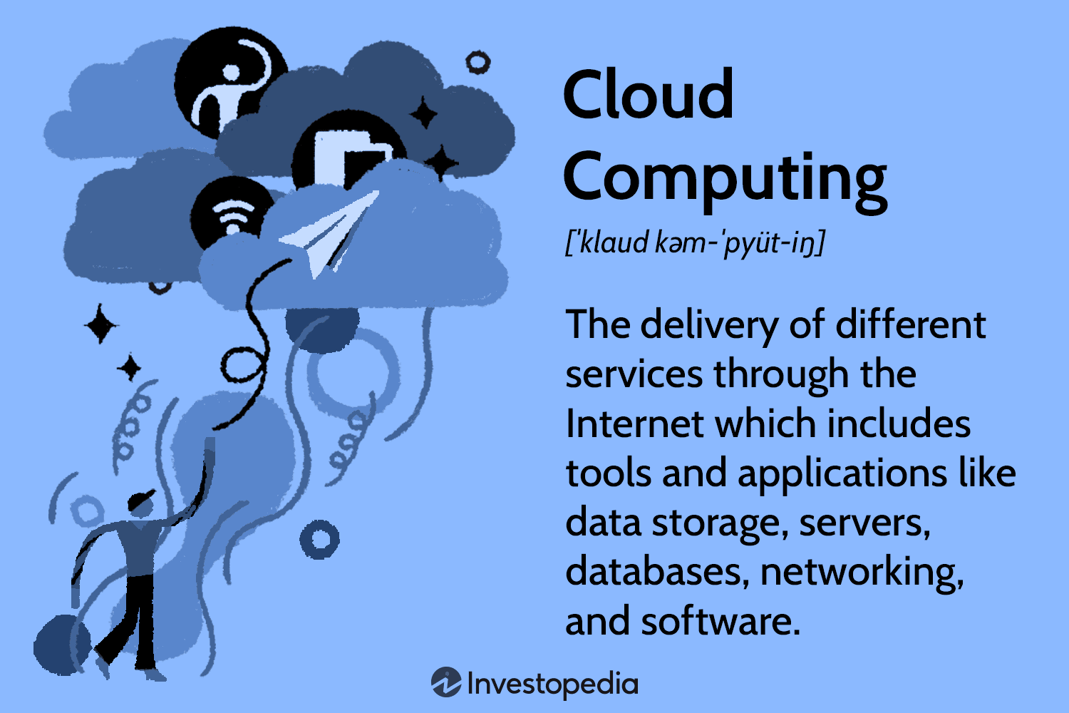
What is Cloud Computing
Cloud computing is the delivery of computing services—including servers, storage, databases, networking, software, analytics, and intelligence—over the internet (“the cloud”) to offer faster innovation, flexible resources, and economies of scale.

Slide 14
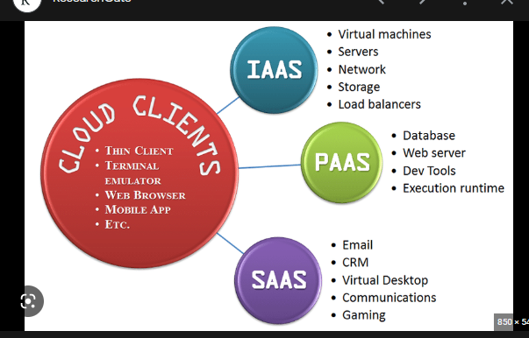
Services Provided By Cloud Computing
The wide range of services offered by cloud computing service providers can be categorized into three basic types:
Infrastructure as a service (IaaS).
Platform as a service (PaaS).
Software as a service (SaaS).

Slide 15
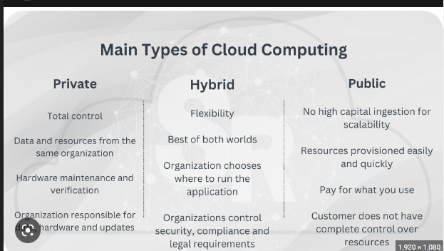
Types of Cloud
Examples of Private Cloud Providers
HPE. Hewlett Packard Enterprise (HPE)
VMware. VMware offers two types of private cloud solutions.
Dell. Dell EMC offers two private cloud products.
Oracle.
IBM.
Examples of Public Cloud Providers
Amazon Web Services (AWS), Microsoft Azure, and Google Cloud Platform (GCP)

Slide 16
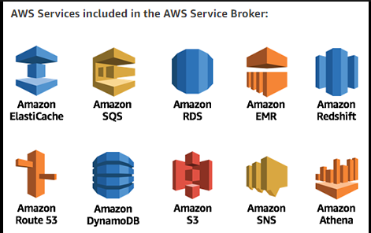
Services We will Learn About in AWS
EC2
Service---->Compute---->EC2
(To create virtual machine in window and Linux)
t2.micro:T2 instances are Burstable Performance Instances that provide a baseline level of CPU performance with the ability to burst above the baseline.

Slide 17
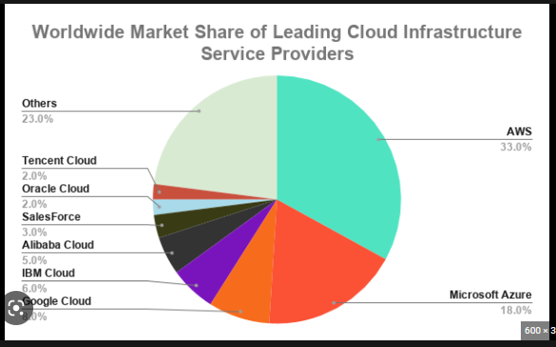
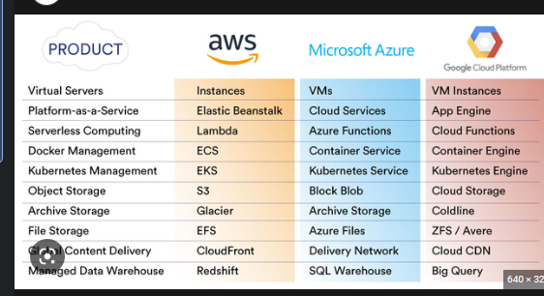
Difference Between AWS,MICROSOFT AZURE,GOGLE CLOUD

Slide 18
linux Command
sudo yum install httpd
y
sudo vi /var/www/html/index.html
i
<html>
<h1>
hello world
</html>
</h1>
esc
:wq
sudo service httpd start

Slide 19
Load Balancer
A load balancer is a device that acts as a reverse proxy and distributes network or application traffic across a number of servers.

Slide 20
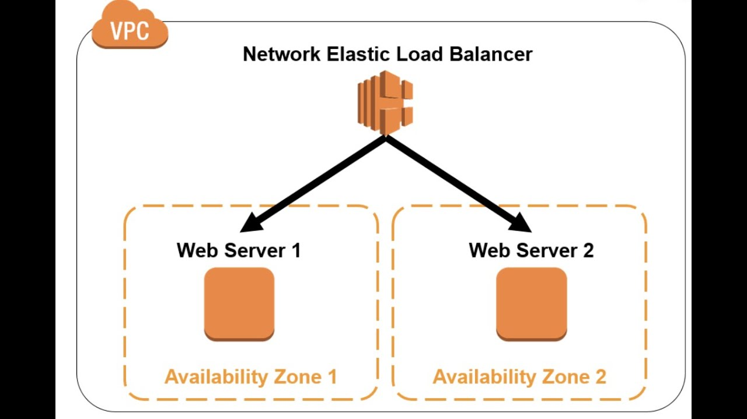
Load Balancer
Load balancer types
Application Load Balancer.
Network Load Balancer.
Application Load Balancer and Network Load Balancer considerations.
Classic Load Balancer

Slide 22
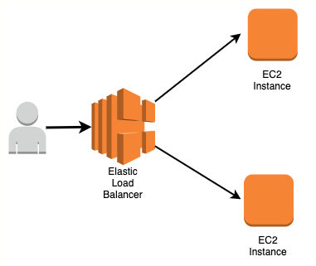
Load Balancer In AWS
In AWS load balancer there will be 2 or more than two servers and the load will be balanced simulteneously between servers.

